Slide 1


TRACKING THE CITIES..!
Sujith K S
Amal Narayanan
Chaithanya K S
Suchithra A S
Anurag N P

Slide 2
? THE QUESTION
City data base
Name
Insert
Delete
Coordinates
Find
Save to
Display

Slide 3

But How?
ARRAYS & POINTERS…!
Two programs…!
A comparative Study…!

Slide 4
Program Contains
Enlisted a number of cities and its coordinates.
Operations was included…
Insert => To insert database of a new city.
Search => For finding cities by name or coordinate. Finds the cities in between a coordinate
Display => Displays the database
Save to => Saves to file
Delete => Removes the unwanted city database from list

Slide 5
Index
Insert (struct_name, a[ ] , x , y)
Display (struct_name)
Save to (struct_name)

Slide 6
Index (cont…)
search
(struct_name,x,y)
(struct_name,a[ ])
Delete
(struct_name,x,y)
(struct_name,a[ ])

Slide 7


Slide 8


Slide 9

Data base using linked list implementation

Slide 10
Implementation using singly linked list
Node:-
typedef struct node
{
char a[];
Int x,y;
Struct node *n;
};

Slide 11
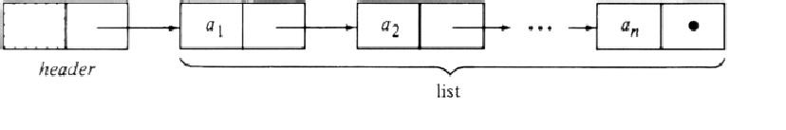
Main function & Interface
struct node *h; // head node
struct node *t;
t=h;
t->n = NULL; //last node is null
NB:- to access elements, we use the ‘->’ operator instead of ‘.(dot)’

Slide 12
Inserting elements:-
add(struct node *t,data)
{
while (t->n != null)
t=t->n; // finds the last node
t->n=(struct node *)malloc(sizeof(struct node));
//memory allocation for the new node
t->data=data;
t->n = NULL; //last node
return
}
{

Slide 13
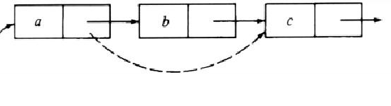
Deleting elements
delete(struct node *t,data)
{
Struct node *prev,;
while(t->n!=null)
{
prev=t;
t=t->n;
if (t->data == data)
{
p->n=t->n; // remove the node t
free(t); //deallocate memory
}

Slide 14
Saving to File:-
savetofile(struct node *t)
{
file *p;
p=fopen(‘’filename.dat’’,’’w’’);
while(t->n!=null)
{
t=t->n;
fprintf(p,t->data);
}
fclose(p);
return
}

Slide 15
Displaying the elements
printall(struct node *t)
{
if (t->n==NULL)
printf(“The Database is empty\n”);
else
{
While(t->n!=NULL)
{
t=t->n;
printf(t->data); //printing the data one by one.
}
return;

Slide 16
Searching entries
SEARCH
BY COORDINATES
BETWEEN TWO LATTITUDES
BETWEEN TWO LONGITUDES
BY NAME
BETWEEN TWO SET OF COORDINATES

Slide 17
Search by coordinates
flag=0;i=0;
while(t->n!=NULL)
{
t=t->n;
if (coord1<=t->data<=coord2) // check whether the data
{ is b/n the required values.
flag+=1;
printf(t->data);
}
i++;
}
if (flag==0)
printf("No matches found ");

Slide 18
Search by name
Look(struct node *t,coord1,coord2)
{
t=t->n
while (t!=NULL) {
flag=1;
if (strlen(a)==strlen(t->a) { //comparing the lengths
flag=0;
for (j=0; j<strlen(a); j++)
if (a[j] !=t->a[j]) //letter by letter comparison
flag=1; }
if (flag==0) {
Print(t->data);
}
t=t->n;
}

Slide 19
Comparison
ARRAY | LINKED LIST
Need of indexed/random access. (max length and length of array) | Need the head only.
Easy(in our prog) to insert new entries since all new entries are added to the last of array. | Difficult(in our prog) for inserting as we have to find the tail before inserting.
Difficult to delete an entry, as the whole array after that have to shifted after that. | Easy to delete nodes from anywhere.
Cannot extend more than a maximum length (pre-defined). | No limit for the number of entries.

Slide 20
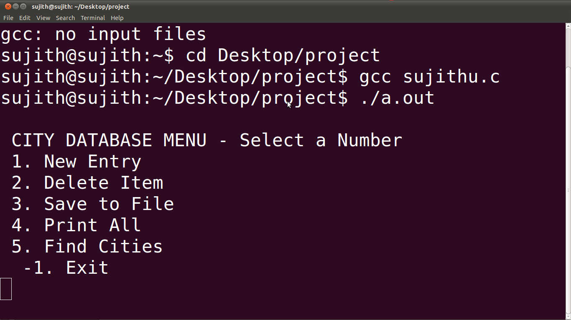
Screenshots – Main Menu

Slide 21
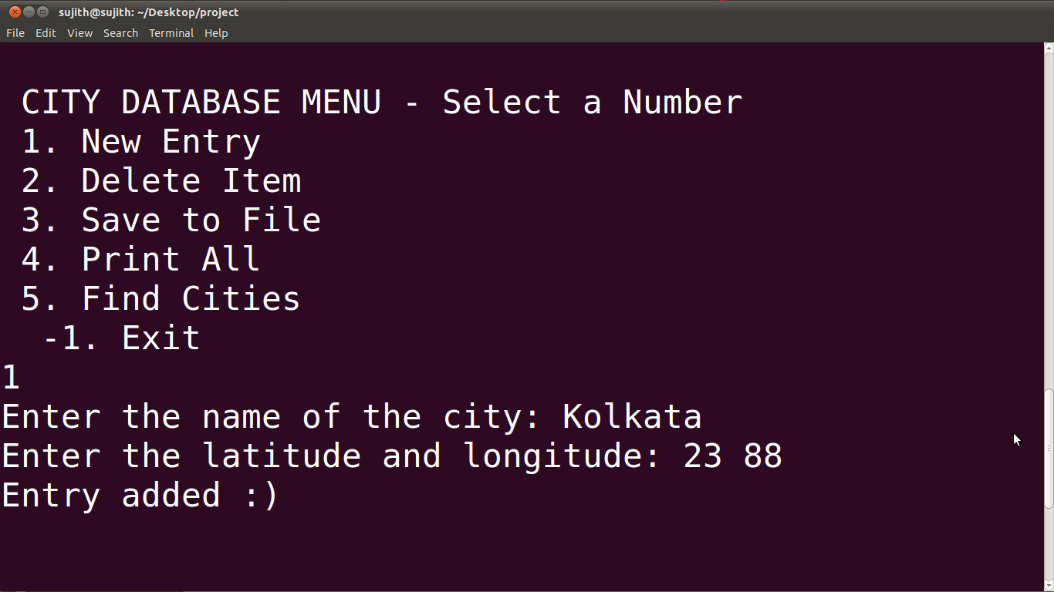
Screenshots-New entry

Slide 22
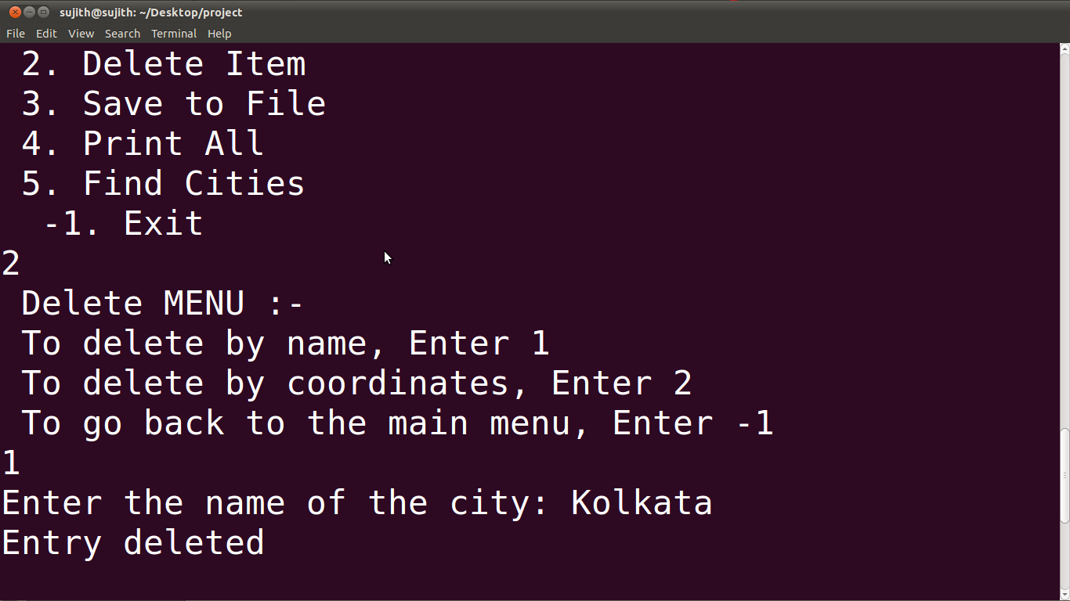
Screenshots - Delete

Slide 23
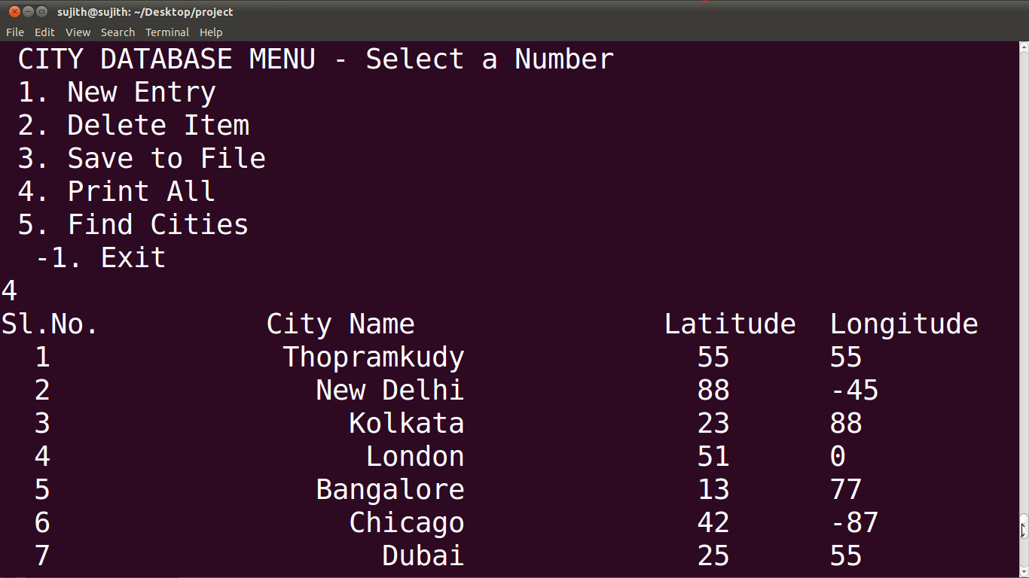
Screenshots – Print all

Slide 24
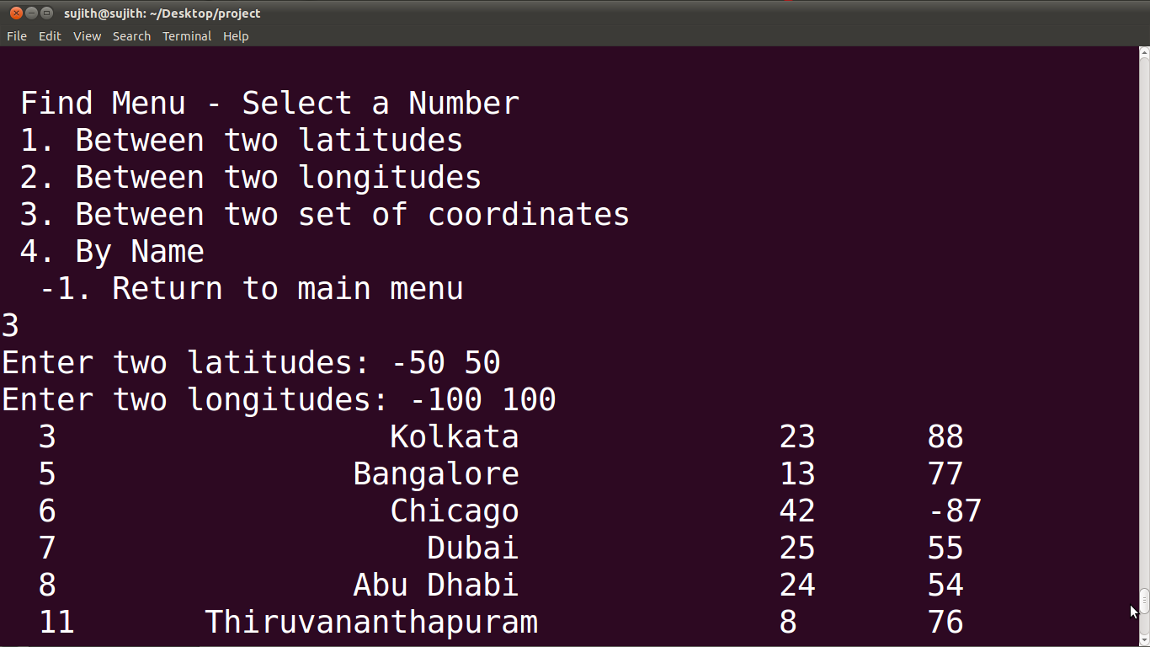
Screenshots - Search

Slide 25

`

Slide 26


